Slide 1





A P I
Pokemon gotta catch em all
API's gotta fetch em all
by Sushant Mishra

Slide 2
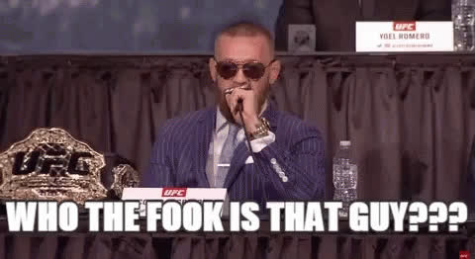

Slide 3
SO HELLO EVERYONE !!
•
Name: Sushant
•
Age: 90000+
•
Your boi is a Hackerabadi
•
Stuff I like to do:
Code (Web Dev.)
Music (Hip-Hop/Rap)

Slide 4

TODAYS AGENDA

Slide 5
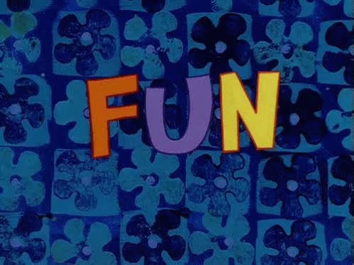

Slide 6
A
P
pplication
rogramming
I
interface

Slide 7

WHAT IS AN
I
?
interface

Slide 8



YOU
WAITER
KITCHEN
CLIENT
INTERFACE
SERVER

Slide 9


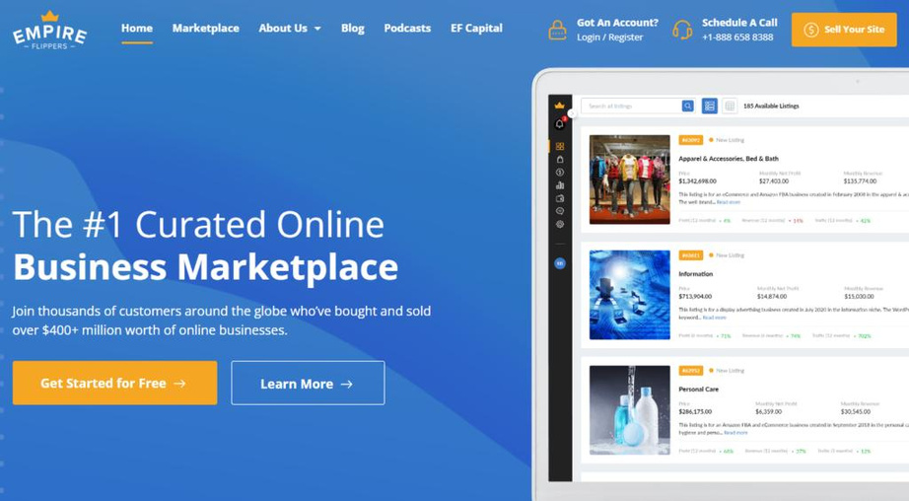
EXAMPLES
TV Remote
Radio
Website

Slide 10




SO THEN AN API IS
An Interface that connects your program with someone else's program.
A P I

Slide 11
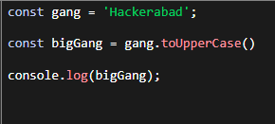
GUESS THE API
A.
B.
C.

Slide 12
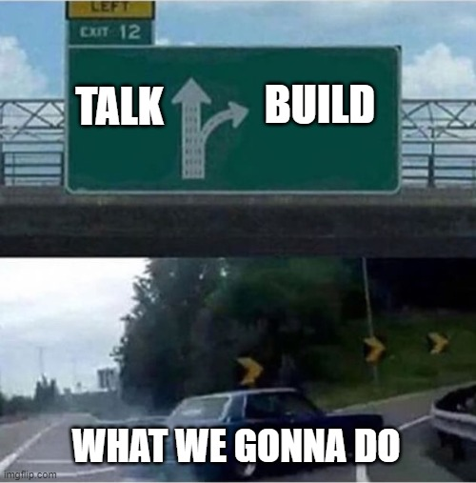

Slide 13
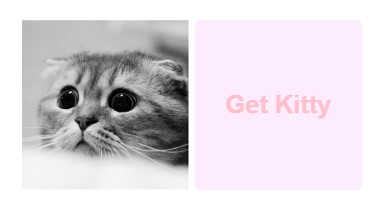
CAT BOT

Slide 14
Requirement
Clicking the button should
Fetch Data
Display the Cat Image

Slide 15
Visit
https://github.com/Sushants-Git/Hackout-APIs
Link in the chat

Slide 16
Wait it's already over ...
Thank a lot for comming !!!!

Slide 17

Some Resources to Learn about API

